Slide 1
专题四 代词
高考英语
北京市专用

Slide 2

目 录
体系透视
重难透析
1.物主代词
2.反身代词
3.指示代词
4.不定代词
5.it的用法
考点针对练

Slide 3
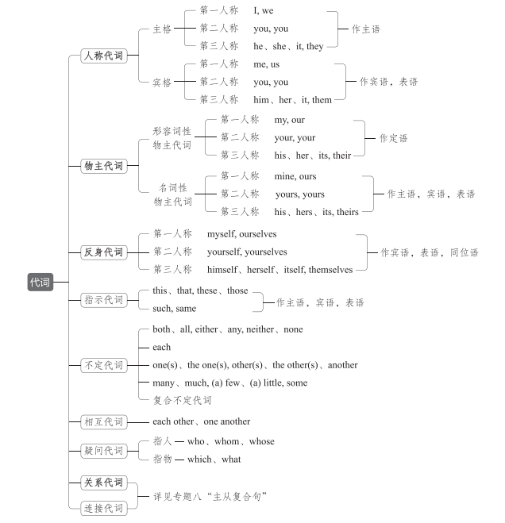
体系透视

Slide 4
重难透析
1.物主代词
(1)形容词性物主代词不能单独使用,可用在名词前作定语或在动名词前作逻辑主语。
He raised his hat in salute as the lady approached.
当那位女士走近时,他举帽致意。
Would you mind my opening the window?
你介意我开窗吗?
(2)形容词性物主代词还可与own连用,表示强调。
I saw it with my own eyes.那是我亲眼看见的。

Slide 5
(3)名词性物主代词相当于“形容词性物主代词+名词”,可用作主语、宾语或表语。
We'll have to separate his things from yours.
我们得把他的东西同你的分开。
(4)名词性物主代词还可与of连用,构成双重所有格。
I know each brother of his.
我认识他的每个兄弟。

Slide 6
2.反身代词
(1)反身代词可以在句中作宾语、表语或同位语。
By being positive about myself and my body, I became both happier and healthier.(作介词
的宾语)通过积极看待自我和自己的身体,我变得更加快乐,也更加健康了。
Can you drag yourself away from playing the mobile phone?(作动词的宾语)
你能停止玩手机吗?
I haven't been feeling myself lately.(作表语)我近来一直感觉不舒服。
Communication itself is probably best understood as a dialogue process.(作同位语,表示强
调)沟通本身可能最好被理解为一个对话过程。

Slide 7
(2)含有反身代词的固定搭配
①与介词搭配
by oneself独自地 for oneself为自己
in oneself本身,本质上 of oneself自动地
to oneself独享
②与动词搭配
accustom/adapt oneself to 习惯于,适应 amuse oneself 自娱自乐
apply oneself to专心于 behave oneself表现得体,有礼貌
devote/dedicate oneself to致力于,献身于 dress oneself给某人自己穿衣服
help oneself to为自己取用 make oneself at home舒适自在;无拘无束
seat oneself就座

Slide 8
3.指示代词
(1)指示代词可用作主语、宾语或表语。
(2)this和these一般用来指下文将要讲到的事物,而that和those则指上文已经讲过的事物。
How about this: you stay here while I go to the store?
你待在这里,我去商店,这样好不好?
He didn't come. That is why he didn't know.
他没来,那就是他不知道的原因。

Slide 9
注意 this和that也可用于表示程度,此时用作副词,相当于so,意为“如此,那么”。
They never expected to be quite this successful.
他们从未想到会如此成功。
I can't solve the problem. I am not that clever.
这个问题我解决不了。我没那么聪明。
(3)such可用作指示代词,指代上文所述的人或事物。
If you retained a receipt, please enclose a copy of such. 如果你留有收据,请附上收据副本。

Slide 10
注意 such可也用作限定词,与名词连用作定语,意为“这样的”。其前也可加不定代
词。
There's no such thing as a free lunch.
天下没有免费的午餐。
Any such request is sure to be turned down.
任何这类要求肯定会碰壁。

Slide 11
4.不定代词
(1)both、all、either、any、neither、none
 | 都 | 任何一个 | 都不
两者 | both | either | neither
三者或三者以上 | all | any | none
I've bought two books;you can have either.
我买了两本书,你要哪本都行。
Any child who breaks the rules will be punished.凡违反规定的孩子都要受罚。
None of these pens works.这些钢笔没有一支能用。
易混易错 部分否定与全部否定
all、both等与not连用时,表示部分否定;如果表示全部否定,需用none或neither。

Slide 12
(2)each
each作不定代词,表示两个或两个以上中的每一个,侧重个体,强调“每一个”,可在句
中作主语、宾语或同位语,也可用作定语。作定语时,常考查与every的区别。every表
示三个或三个以上中的每一个,侧重整体,强调全部。
Each of my children goes to a different school.
我的几个孩子各自在不同的学校上学。
Every student has to take the examination.
= All students have to take the examination.
每个学生都必须参加考试。

Slide 13
注意 ①each作主语的同位语时,谓语动词仍与句子主语保持一致。
We each have a different point of view.
我们每个人都有不同的观点。
②each可与of连用,后接名词复数;而every不能与of连用。
Each of the answers is worth 20 points.
每题为20分。
③every可与not连用表示部分否定,意为“并非每一个”;而each通常不用于否定句。
I couldn't hear every word of his speech.
他的演讲并非每一句我都能听见。

Slide 14
(3)one用于指代可数名词,既可以指人,又可以指物。
用法 | 不定代词 | 表示 | 替换词
代替上文出现的单数名词 | one | 泛指 | a/an+单数名词
 | the one | 特指 | that或the+单数名词
代替上文出现的复数名词 | ones | 泛指 | 零冠词+复数名词
 | the ones | 特指 | those或the+复数名词
The books on the desk are better than the ones(=those/the books) under the desk.
桌子上面的书比桌子下面的那些好。

Slide 15
5.it的用法
(1)基本用法
用法 | 例句
指代上文提及的事物 | The other room has two beds in it.另一个房间里有两张床。
用以明确身份或指代不明性别的婴儿 | It's your mother on the phone.是你母亲来的电话。 The baby cried because it was hungry.这个婴儿因饥饿而啼哭。
指代天气、距离、环境、季节、温度、地点、日期等 | It is nine o'clock sharp now.现在是9点整。(指时间) It is raining hard outside.外面雨下得正大。(指天气) It's over 200 miles from London to Manchester. 从伦敦到曼彻斯特有两百多英里。(指距离)

Slide 16
(2)特殊用法
①作形式主语
•代替不定式
+to do sth.
•代替动名词
It+be+ +doing sth.

Slide 17
•代替主语从句
②作形式宾语
•动词+it+宾补+动名词/不定式/that从句
I think it no use crying.
我认为哭是没有用的。
I find it easy to get along with the newcomer.
我发现和新来的人相处很容易。

Slide 18
We consider it of great importance that theory must be combined with practice. 我们认为
理论与实践相结合是极为重要的。
•表示爱、恨等情感的动词+it+宾语从句
此类动词有dislike、appreciate、hate、like、love等。
I hate it when people talk with their mouths full. 我讨厌人们满嘴东西时和别人说话。
③用于固定短语
as it is事实上;照目前情况
be worth it值得
call it a day到此为止

Slide 19
it (all) depends视情况而定
make it准时到达;获得成功
take it easy放轻松;别着急
when it comes to...说到……
④用于固定句型
•强调句型:It be+被强调部分+that/who+其他成分
It was at 3 o'clock that the rescue team arrived at the disaster-stricken area.
救援队是在3点钟到达受灾地区的。

Slide 20
•It's (high) time+that从句
It's high time that the meeting was over. 会议早该结束了。
•It be+the+序数词+time+that从句
It's the second time that he has failed the driving test.
这是他第二次没能通过驾照考试。
•It is/has been+时间段+since从句
It is/has been years since we parted.自从我们分别以来已经有很多年了。
It is several years since he lived here.他不住在这里已经好多年了。
•It be+时间段+before从句
It will be years before we meet again.要过几年我们才能重逢。
It was not long before he came back.没过多久他就回来了。

Slide 21
考点针对练
1. Neptune is a gas giant in ________(we) solar system, similar to Jupiter.
解析 句意:海王星是我们太阳系中的一颗气态巨行星,类似于木星。设空处在in(介
词)后,在solar system(名词)前,故应用形容词性物主代词our。
our

Slide 22
2. The Chinese Ancient Tea Museum was officially unveiled(揭幕) at the ceremony, open-
ing ________(it) first exhibition: The Avenue of Truth—A Special Exhibition of Pu'er Tea.
解析 句意:在开幕式上,中华古茶博物馆正式揭牌,开启了它的第一个展览:大道遗真
——馆藏普洱茶专题展。名词exhibition前用形容词性物主代词。故填its。
its

Slide 23
3. As the song goes, this long and winding road “will never disappear”, and it will al-
ways stick in the visitor's memory. It sure does in _________(I).
解析 句意:正如歌中所唱,这条漫长而又曲折的道路“永远不会消失”,它将永远留在
游客的记忆中。它当然也会留在我的记忆中。设空处用名词性物主代词mine代替my
memory。
mine

Slide 24
4. This area, with ________(it) unique and breathtaking natural beauty, must be well pre-
served for all people of the nation to enjoy—as a national park.
解析 with为介词,其后的宾语为beauty,设空处应用形容词性物主代词来修饰beauty。
故填its。
its

Slide 25
5. She was extremely pretty, and her house was a reflection of ____________(she), everything
in good taste and in perfect order.
解析 句意:她非常漂亮,她的房子反映了她本人(的品味),一切都很高雅,井井有条。此
空与her指代的人一致,强调她本人,所以要用反身代词herself。
herself

Slide 26
6. As well as looking at exhibits, visitors can play with computer simulations(模拟)and
imagine _______________(they) living at a different time in history or walking through a
rainforest.
解析 句意:除了观赏展品,游客(还)可以玩电脑模拟(游戏),想象他们自己生活在一个
不同的历史时期或漫步在热带雨林中。设空处作imagine的宾语,与主语visitors指的是
同一群人,故使用反身代词。
themselves

Slide 27
7. Readers are encouraged to continue exploring the digital world with the guidance of ____
_______(we) Further Resources section featured in each volume.
解析 句意:我们鼓励读者运用我们在每一卷的参考资料部分提供的指导继续探索数
字世界。修饰Further Resources section,应用形容词性物主代词。
our

Slide 28
8. Data about the moon's composition, such as how much ice and other treasures it con-
tains, could help China decide whether ________(it) plans for a future lunar(月球的) base are
practical.
解析 句意:关于月亮构成的数据,比如它含有多少冰和其他宝藏,可以帮助中国确定其
未来建月球基地的计划是否可行。设空处作名词plans的定语,需用形容词性物主代词;
根据提示词it可知设空处填its。
its

Slide 29
9. When the gorillas and I frightened each other, I was just glad to find _________(they)
alive.
解析 设空处作动词find的宾语,应用宾格,故填them,指代上文的gorillas。
them

Slide 30
10. It is so easy to let an online course slide, but _________(you) grades will suffer as a re-
sult.
解析 此处表示“你的成绩”,应使用形容词性物主代词,故填your。
your

Slide 31
11. Nervously facing challenges, I know I will whisper to ___________(I) the two simple
words “Be yourself”.
解析 此处指低声对自己说,从句的主语和宾语指同一个人,故设空处应填反身代词
myself。
myself

Slide 32
12. Little by little, these different kinds of life got used to one another and formed ______
____(they) own ecosystem.
解析 设空处指代these different kinds of life,与own连用,共同修饰名词ecosystem,表示
强调,故填their。
their

Slide 33
13. After a while, she discovered that surfing the Internet could help ________(she) feel less
lonely and bored.
解析 设空处作help的宾语,应用宾格形式。
her

Slide 34
14. If you want to go to the party with me, you should behave ________________________
(you) well.
解析 句意:如果你(们)想和我一起去参加聚会,你(们)应该举止得体。behave oneself
意思是“表现得体,有礼貌”,因此填yourself或yourselves。
yourself/yourselves

Slide 35
15. Andrew Reynolds, a cheerful fellow in ________(he) early 30s, pilots Sydney ferryboats
for a living.
解析 句意:安德鲁·雷诺兹是一个快乐的小伙子,30岁出头,靠开悉尼的渡轮谋生。in
one's early 30s意为“某人30岁出头”,此处应使用形容词性物主代词。故填his。
his

Slide 36
16. But even this dismissal suggests something: perhaps, just like life ___________(it)
throughout the universe, the rise of ALife will prove unavoidable.
解析 此处表示“也许,就像宇宙中的生命本身一样,人造生命(ALife)的崛起将会是不
可避免的”。设空处作life的同位语,意为“它自己”,表示强调,故填反身代词itself。
itself

